Slide 1
PHYS 304: Lecture 11 (Intro to) Quantum Mechanics
Sept-Dec 2021 Edition
Jeff Young
brimacombe Rm 278, young@phas.ubc.ca

Slide 2
Review of key points regarding the finite square well potential
For the finite square well potential, there are a finite number of bound-to-the-well stationary state solutions of the SE for a discrete set of energies above the minimum potential in the well region. They are bound because they are exponentially decaying outside of the well.
In the limit of an infinitely deep well, the energies of these bound states approach those we obtained earlier, but in general they differ, and must be obtained using a transcendental equation that is easy to solve “graphically”. The transcendental equation is obtained using boundary conditions (continuity of the wavefunction and its derivative in the direction of propagation) to connect the solutions of the SE obtained separately in the 3 distinct spatial regions (made distinct by the potentials in those regions).

Slide 3
Review of key points regarding the finite square well potential
As the energy of these states approaches the surrounding potential, they become more and more delocalized in the barrier regions, but remain exponentially decaying. As the energy goes above that in the barrier regions, the solutions of the SE in the barrier regions become sinusoidal, but with a different wavelength (or k value), for a given energy, than the sinusoidal solutions inside the well region. Just like in the free electron case, there is no restriction on the energy above the barrier potentials, and the formal solutions to the SE, that consist of incident, reflected, and transmitted waves in the barrier regions, and backward and forward propagating waves in the well, are not normalizable. These are referred to as “scattering states”, cf bound states. They are still very useful/relevant since one can form normalizable wavepackets out of them. Can you guess what the dynamics of such wavepackets might be like?

Slide 4
Purpose of today’s lecture…
… is to introduce new notation and review concepts from linear algebra in 2D real vector space using that new notation, so as to;
- provide a reference point you can always go back to if you get confused using bra/ket notation in quantum mechanics
- emphasize the importance of being able to use arbitrary orthonormal bases to expand any QM “state”
- provide a very simple example of an “operator” that can be expanded in any basis

Slide 5
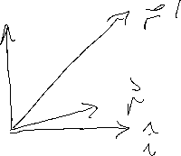

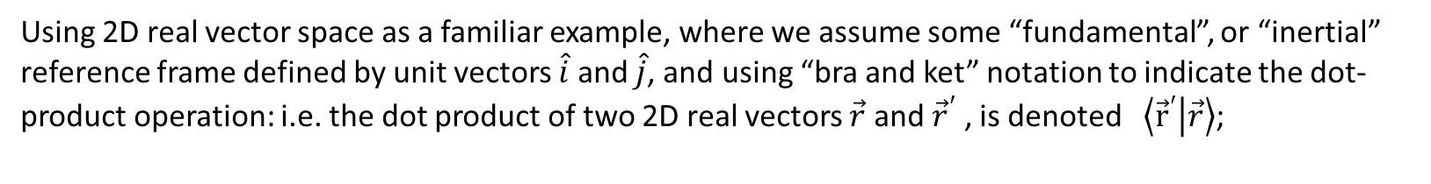
Bra-ket notation applied to 2D Real Vectors
Using 2D real vector space as a familiar example, where we assume some “fundamental”, or “inertial” reference frame defined by unit vectors $\hat{i}$ and $\hat{j}$, and using “bra and ket” notation to indicate the dot-product operation: i.e. the dot product of two 2D real vectors $\vec{r}$ and ${\vec{r}}^{′}$ , is denoted $\left\langle {\vec{r}}^{′} | \vec{r}\right\rangle$;
If $\left\langle \hat{i} | \hat{{\vec{r}}^{′}}\right\rangle =x^{′}$ and$\left\langle j | \hat{{\vec{r}}^{′}}\right\rangle =y^{′}$, the explicit vector associated with ket $\left|{\vec{r}}^{′}\right\rangle$ is:
Notes:
Emphasize that r and r’ are immutable vectors, independent of what basis vectors you use to define them with respect to.

Slide 6


More on bra and ket notation
The explicit vector associated with $\left\langle {\vec{r}}^{′}\right|$is:

Slide 7



More on bra and ket notation
If you get rid of all the “primes”, ‘ , in the above, the corresponding explicit vectors associated with $\left|\vec{r}\right\rangle$ and $\left\langle \vec{r}\right|$ are:

Slide 8






More on bra and ket notation
Then the vector form of $\left\langle {\vec{r}}^{′} | \vec{r}\right\rangle$ in terms of $x,y,x^{′},y^{′}$ is:

Slide 9


















More on bra and ket notation
One can always write $\left|\vec{r}\right\rangle =\left[\left|\hat{i}\right\rangle \left\langle \hat{i}\right|+\left|\hat{j}\right\rangle \left\langle \hat{j}\right|\right]\left|\vec{r}\right\rangle .$ Proof:
Notes:
Let them work on this for a bit.
The first step is very important to be familiar with. Big difference in order of vectors and transposed vectors in equations. Transpose times a vector is an inner product, and a c number, vector left multiplying a transpose is effectively a matrix.
NOTE THAT THIS APPLIES TO ANY ORTHONORMAL BASIS SET

Slide 10
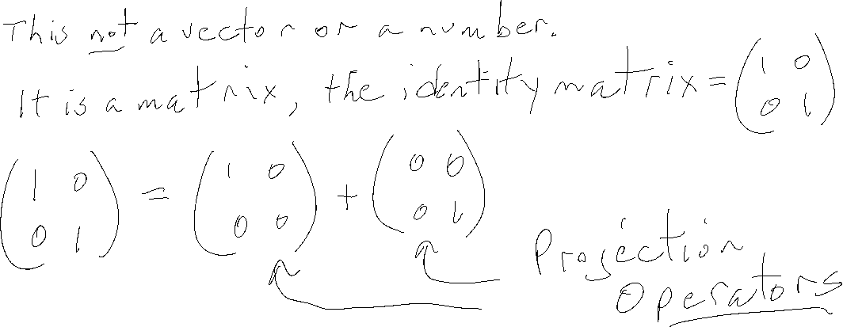
More on bra and ket notation
Why does this imply that $\left|\hat{i}\right\rangle \left\langle \hat{i}\right|+\left|\hat{j}\right\rangle \left\langle \hat{j}\right|$ is a “unity operator” in 2D real vector space?
Notes:
Dwell on fact it is an operator, not a number or a vector!!!

Slide 11







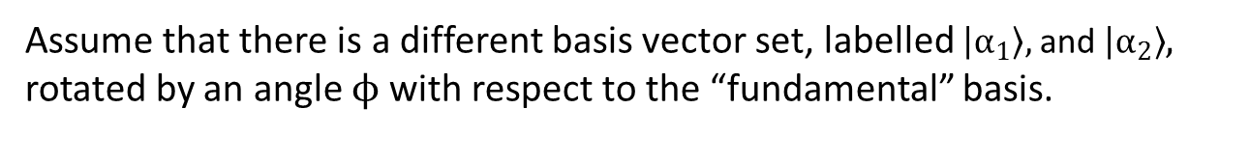
Different bases
Assume that there is a different basis vector set, labelled $\left|α_{1}\right\rangle ,$ and $\left|α_{2}\right\rangle$, rotated by an angle ϕ with respect to the “fundamental” basis.
The unity operator in this new basis using bra ket notation is then:

Slide 12
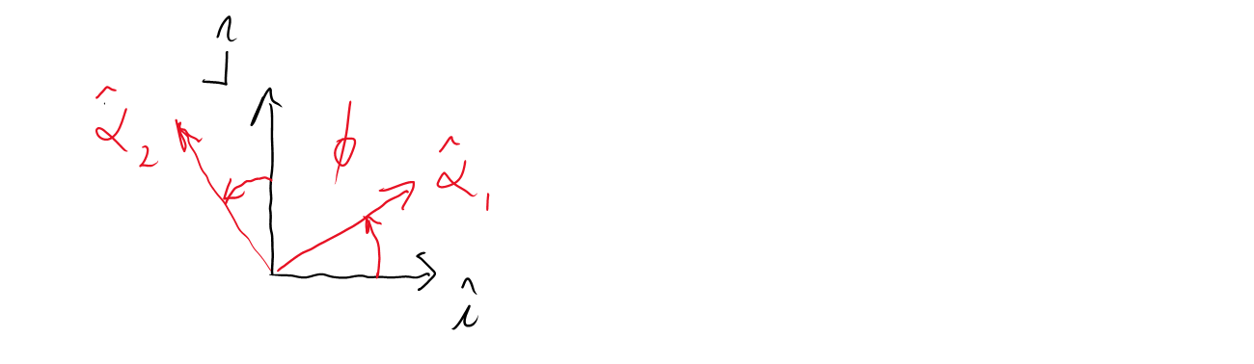





Changing bases
What are the components of $\left|\hat{i}\right\rangle$ and $\left|\hat{j}\right\rangle$ in this new basis?

Slide 13
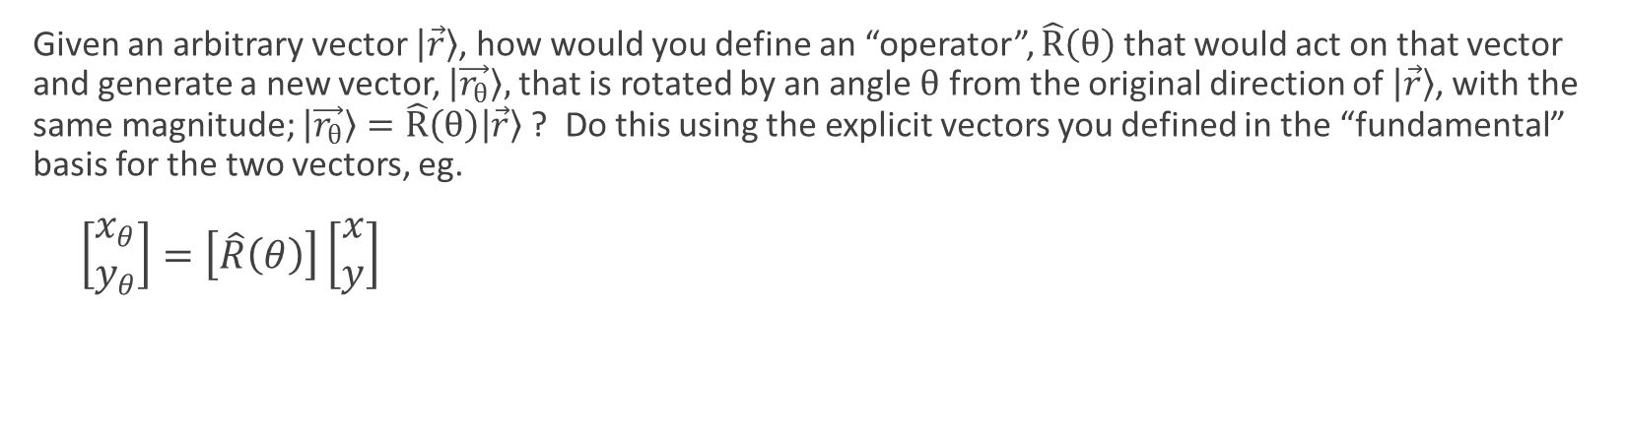
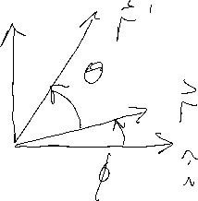
The rotation “operator”
Given an arbitrary vector $\left|\vec{r}\right\rangle$, how would you define an “operator”, $\hat{R}\left(θ\right)$ that would act on that vector and generate a new vector, $\left|\vec{r_{θ}}\right\rangle ,$ that is rotated by an angle $θ$ from the original direction of $\left|\vec{r}\right\rangle$, with the same magnitude; $\left|\vec{r_{θ}}\right\rangle =\hat{R}\left(θ\right)\left|\vec{r}\right\rangle$ ? Do this using the explicit vectors you defined in the “fundamental” basis for the two vectors, eg.
$\left[\begin{matrix}x_{θ} \\ y_{θ}\end{matrix}\right]=\left[\hat{R}\left(θ\right)\right]\left[\begin{matrix}x \\ y\end{matrix}\right]$

Slide 14
The rotation “operator” con’t

Slide 15

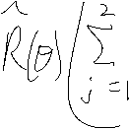

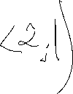














Using arbitrary bases to evaluate immutable operations on immutable vectors
How could you formally represent this 2D real vector rotation operation using bra and ket notation in an arbitrary basis $\left|α_{1}\right\rangle ,$ and $\left|α_{2}\right\rangle$? Hint: insert the unity operator in the equation $\left|\vec{r_{θ}}\right\rangle =\hat{R}\left(θ\right)\left|\vec{r}\right\rangle$ and project onto that basis.
Notes:
Spend a significant amount of time on this, emphasizing this is a critical concept. This applies in ANY orthonormal basis.
Makes very clear how the vectors r and r_theta are immutable, and they and the operation can be materialized in ANY basis.

Slide 16
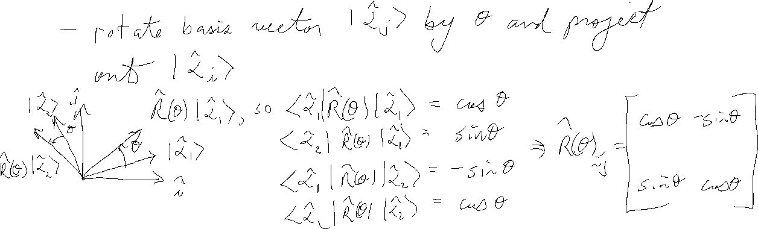
Matrix operators in different bases
Interpret $\left\langle \vec{α_{i}}\right|\hat{R}\left(θ\right)\left|\vec{α_{j}}\right\rangle ,$ and what explicitly are the matrix elements $\hat{R}{\left(θ\right)}_{i,j}$?
Notes:
Emphasize that this is for any orthonormal set of alpha basis vectors…it is basis independent!
But in general, “operators” will have different matrix representations in different bases.

Slide 17

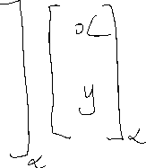






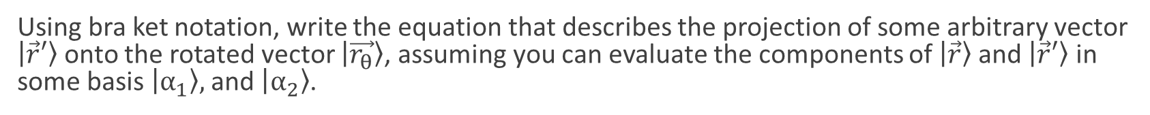








Projections on rotated vectors
Using bra ket notation, write the equation that describes the projection of some arbitrary vector $\left|\vec{r}′\right\rangle$onto the rotated vector $\left|\vec{r_{θ}}\right\rangle$, assuming you can evaluate the components of $\left|\vec{r}\right\rangle$and $\left|\vec{r}′\right\rangle$ in some basis $\left|α_{1}\right\rangle ,$ and $\left|α_{2}\right\rangle$.

Slide 18



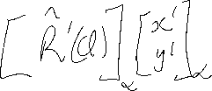






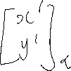

Transpositions
What equation represents the projection of the vector $\left|\vec{r}′\right\rangle$ , rotated by an angle $φ$, onto $\left|\vec{r}\right\rangle$? Use the notation $\hat{R′}\left(φ\right)$for this operator.
Notes:
Already showed that rotation matrix independent of alpha basis.

Slide 19



















Transpositions con’t
What equation represents the projection of the vector $\left|\vec{r}′\right\rangle$ , rotated by an angle $φ$, onto $\left|\vec{r}\right\rangle$? Use the notation $\hat{R′}\left(φ\right)$for this operator.

Slide 20













Transpositions con’t
What equation represents the projection of the vector $\left|\vec{r}′\right\rangle$ , rotated by an angle $φ$, onto $\left|\vec{r}\right\rangle$? Use the notation $\hat{R′}\left(φ\right)$for this operator.

Slide 21
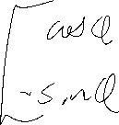


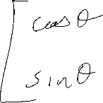






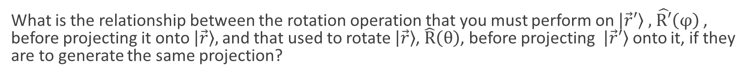




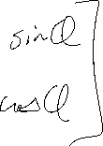




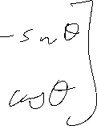
Transpositions con’t
What is the relationship between the rotation operation that you must perform on $\left|\vec{r}′\right\rangle$ $,$ $\hat{R′}\left(φ\right)$, before projecting it onto $\left|\vec{r}\right\rangle ,$ and that used to rotate $\left|\vec{r}\right\rangle$, $\hat{R}\left(θ\right)$, before projecting $\left|\vec{r}′\right\rangle$onto it, if they are to generate the same projection?

Slide 22
Sanity check
Notes:
Sanity/intuition check

Slide 23



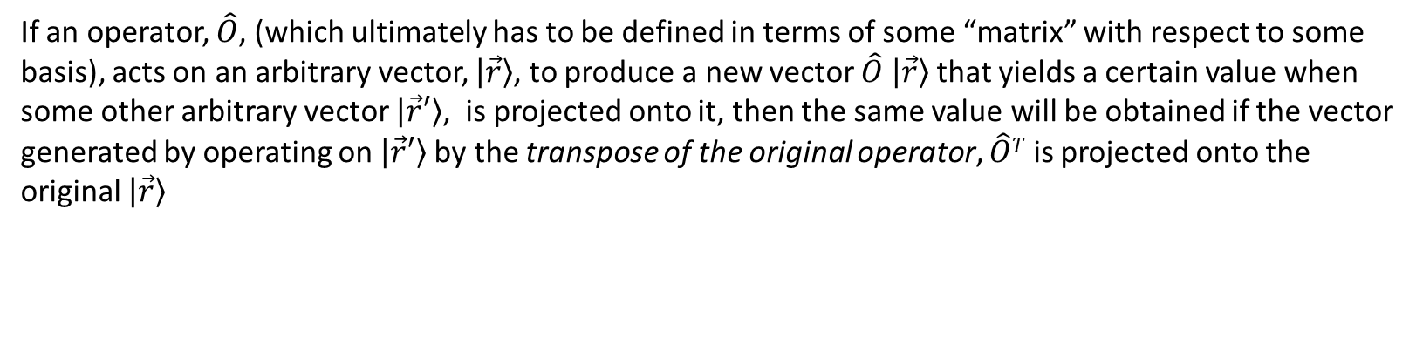




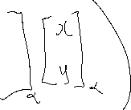
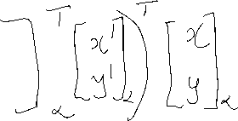
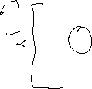




Generalize:
If an operator, $\hat{O}$, (which ultimately has to be defined in terms of some “matrix” with respect to some basis), acts on an arbitrary vector, $\left|\vec{r}\right\rangle$, to produce a new vector $\hat{O}$ $\left|\vec{r}\right\rangle$that yields a certain value when some other arbitrary vector $\left|\vec{r}′\right\rangle$, is projected onto it, then the same value will be obtained if the vector generated by operating on $\left|\vec{r}′\right\rangle$by the transpose of the original operator, $\hat{O}T$ is projected onto the original $\left|\vec{r}\right\rangle$

Slide 24








Tidy up using bra ket notation
If an operator, $\hat{O}$, (which ultimately has to be defined in terms of some “matrix” with respect to some basis), acts on an arbitrary vector, $\left|\vec{r}\right\rangle$, to produce a new vector $\hat{O}$ $\left|\vec{r}\right\rangle$that yields a certain value when some other arbitrary vector $\left|\vec{r}′\right\rangle$, is projected onto it, then the same value will be obtained if the vector generated by operating on $\left|\vec{r}′\right\rangle$by the transpose of the original operator, $\hat{O}T$ is projected onto the original $\left|\vec{r}\right\rangle$

Slide 25
Bi-weekly Quiz #3

